Slide 2
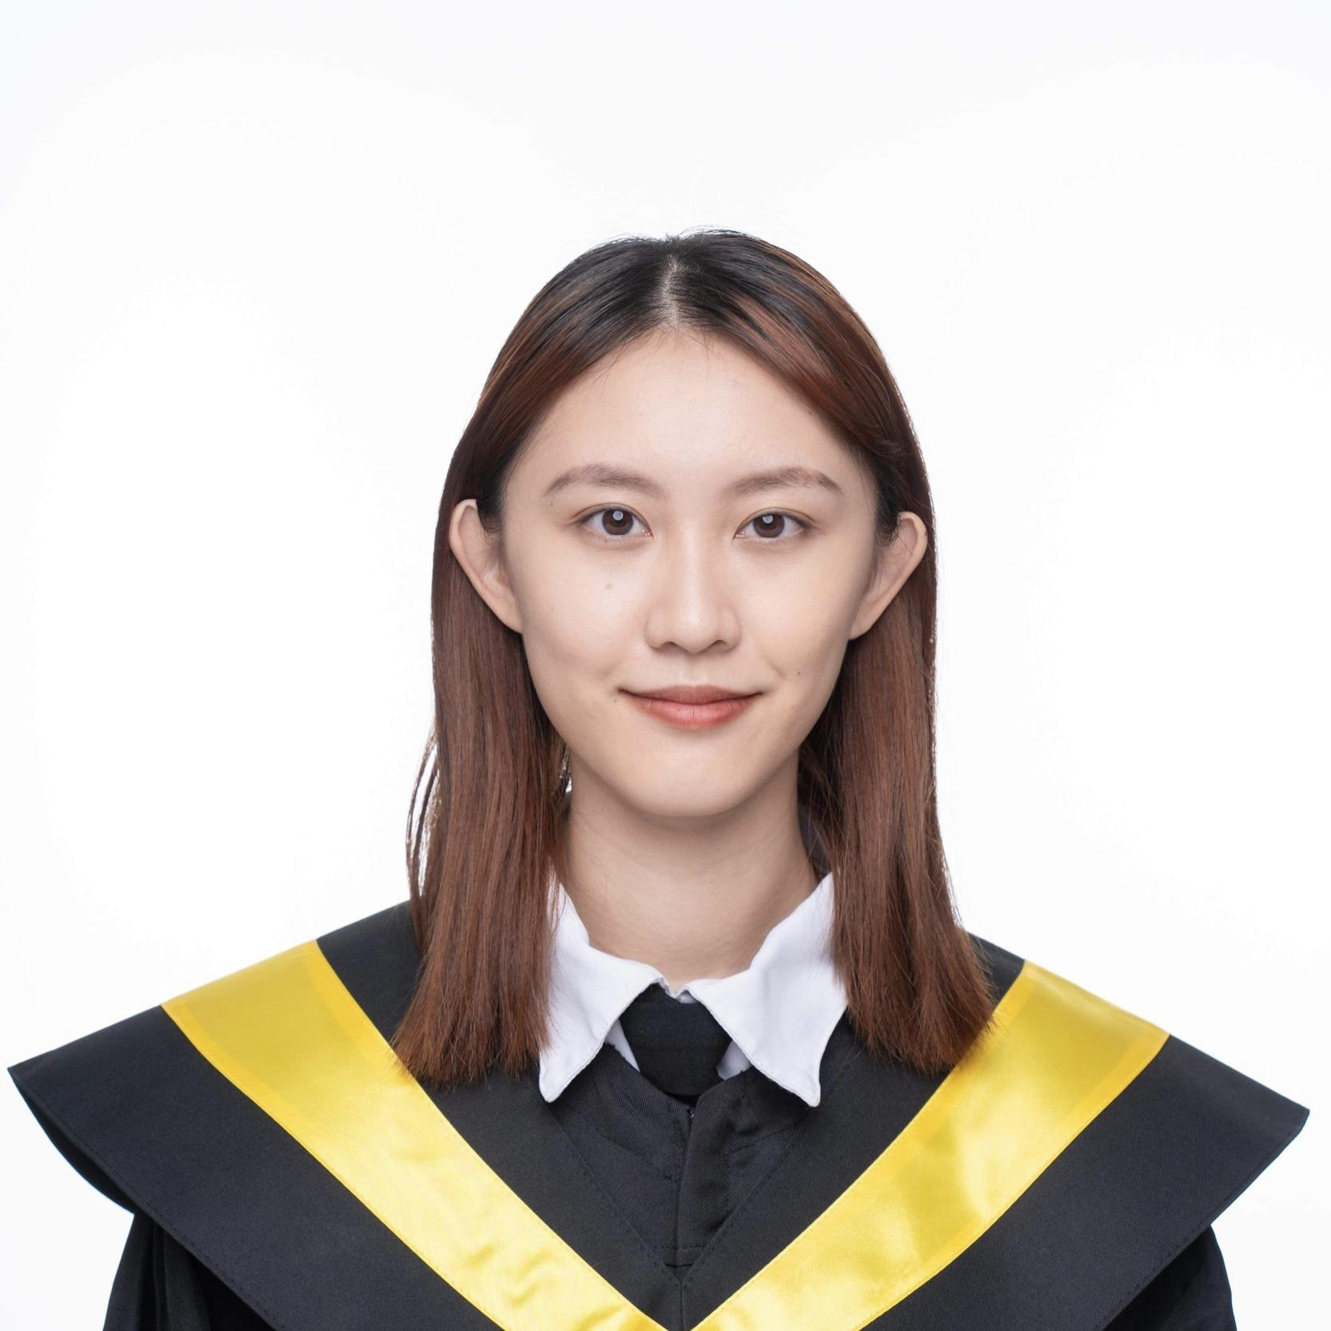
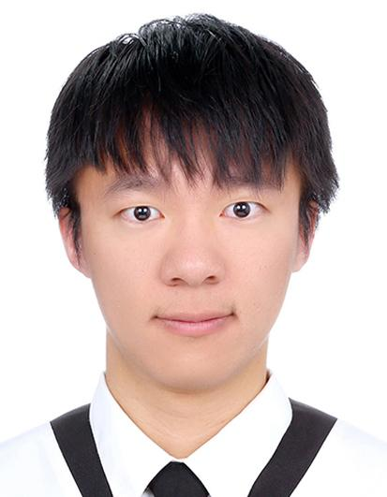
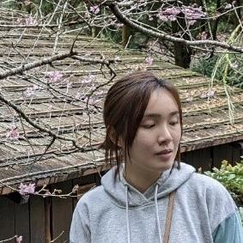
Team Members
蔡博揚 R10922A15
徐榆婷 B07601004
鄭婷卉 B07611046
Faster-RCNN
ViT
ConvNext
YOLOv5
EfficientNet
YOLOv5
NASNet
YOLOv5 - both tasks

Slide 3
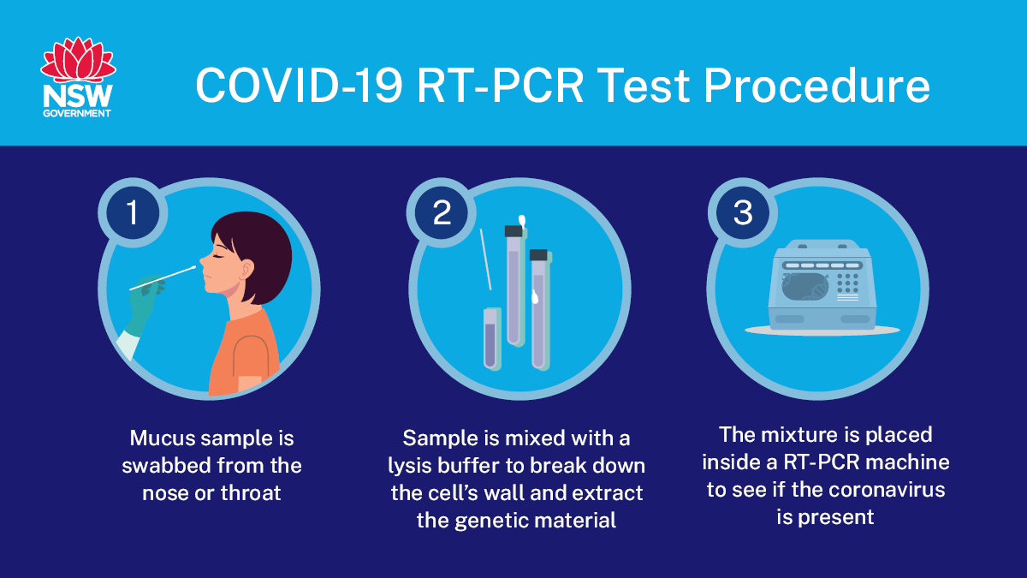
What is the problem?
COVID-19 is an international health problem.
It can be diagnosed by PCR but takes times.
Notes:
COVID-19 can be diagnosed via polymerase chain reaction to detect genetic material from the virus or chest radiograph. However, it can take a few hours and sometimes days before the molecular test results are back.

Slide 4
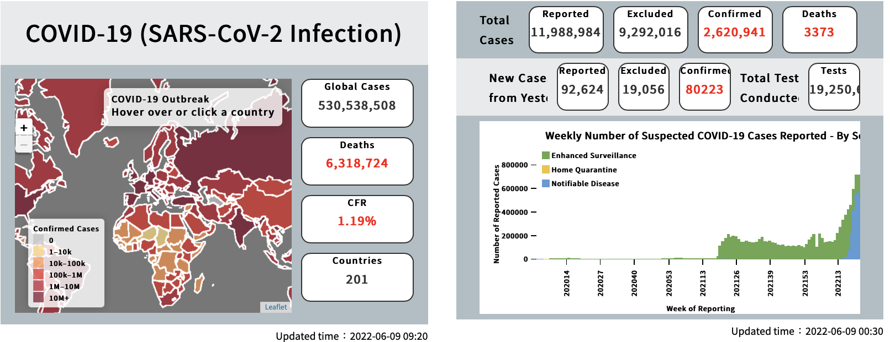
Why is it important?
Pandemic becomes more serious recently.
Infectiousness peaks around one day before symptom and declines between 2-3 days before and 8 days after symptom. (CDC, US)

Slide 5
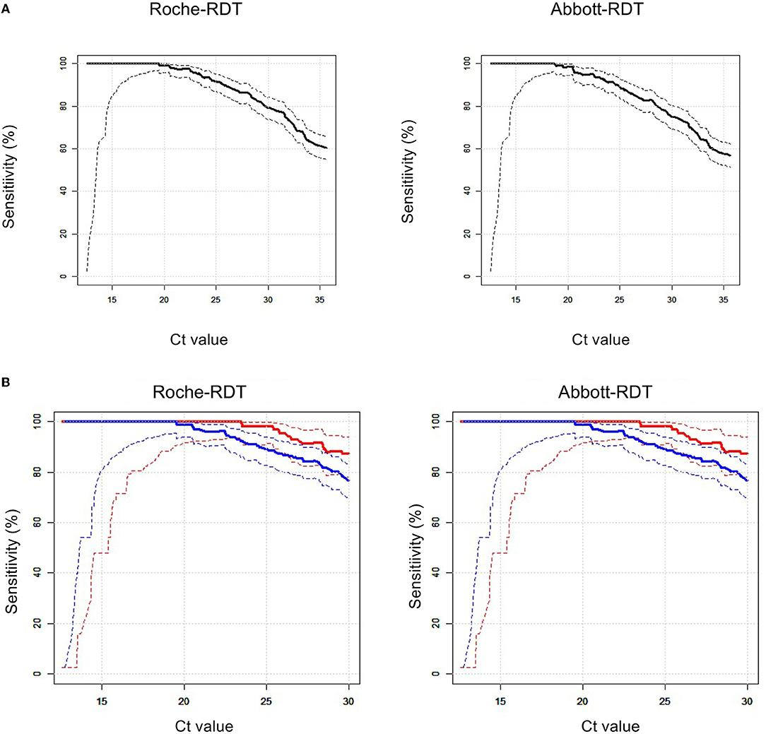
Why is it important?
Rapid antigen tests accuracy
Roche/SD Biosensor: 65.3%
Abbot: 54.2%
PCR accuracy: more than 95%

Slide 6
Solution overview - Chest radiographs detection
Therefore, we try to find another way to have a rapid covid test and can have higher accuracy.
And our solution is chest radiographs detection.
To do the chest radiographs, we need to do two tasks:
1. Localization
2. Classification
Notes:
two main goals
where is the lesion
what is the disease

Slide 7
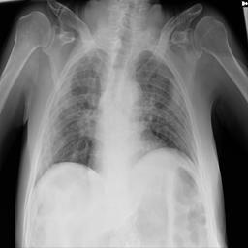
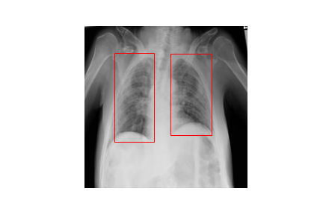
Solution overview - Chest radiographs detection
Localization
Chest X-ray image
Lesion detection
Notes:
two main goals
where is the lesion
what is the disease

Slide 8
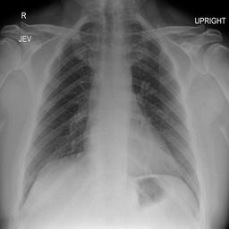
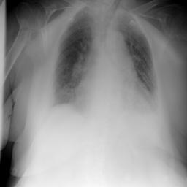
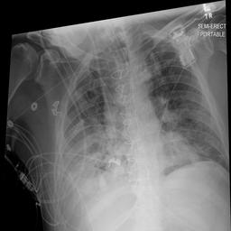
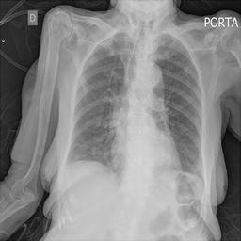
Solution overview - Chest radiographs detection
Classification
Negative
Typical
Indeterminate
Atypical

Slide 9
State of the art on object detection
Deep CNNs can accurately and effectively differentiate normal and abnormal chest radiographs.
R-CNN
YOLO
EfficientDet
Notes:
region with cnn features
found some useful network
easily to implement

Slide 10
Methodology
Faster-RCNN
Vision Transformer
ConvNext
Yolov5
EfficientNet b0
NASNet
Notes:
region with cnn features
found some useful network
easily to implement

Slide 11
Data resources | Datasets
Society for Imaging Informatics in Medicine (SIIM)
Image amount: 6335
2 Level
4 Categories in Study-Level
All the annotation have already been done by SIIM.
Image-Level | With BBbox | Total
Cases | 4295 | 6335
Study-Level | Negative | Typical | Indeterminate | Atypical | Total
Cases | 1676 | 2855 | 1049 | 474 | 6054

Slide 12
Tools / Frameworks used
Pytorch
Keras
Huggingface
Kaggle
Albumentations
Notes:
Predictions (object locations and classes) are made from one single network.
YOLO imposes strong spatial constraints on bounding box predictions, so it struggles to detect small or close objects. generalize to objects in new or unusual aspect ratios or configurations.

Slide 13
Lesion Localization

Slide 14
Faster-RCNN | Training Details
Pre-processing:
Normalization
Data Augmentation
Image size: 256 * 256
Batch size: 4
Epoch:5
Optimizer: SGD
Initial learning rate: 0.001

Slide 15
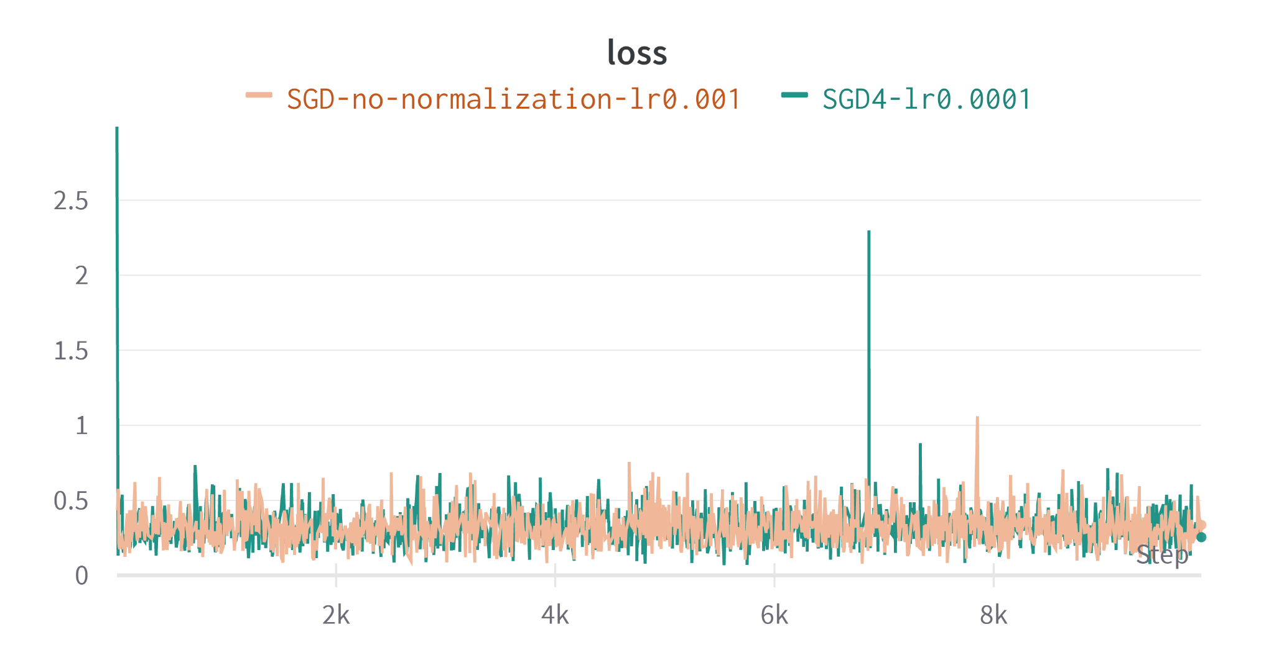
Faster-RCNN | Model Performance

Slide 16
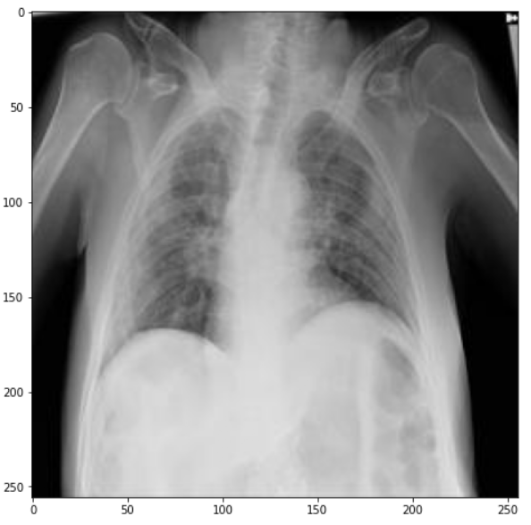
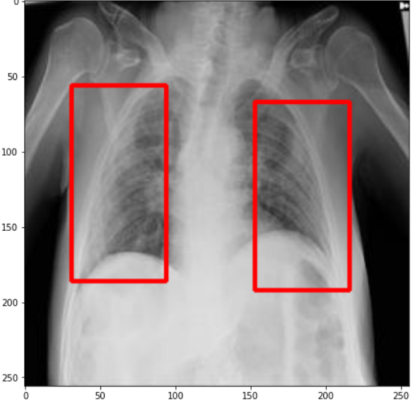
Faster-RCNN | Result

Slide 17
YOLOv5 | Training Details
Pre-processing:
Normalization
Data Cleaning
Image size: 256 * 256
Batch size: 16
Epoch: 100
Optimizer: SGD
Initial learning rate: 0.01

Slide 18
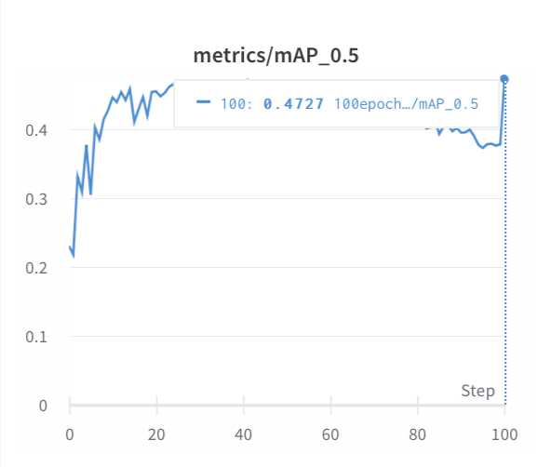
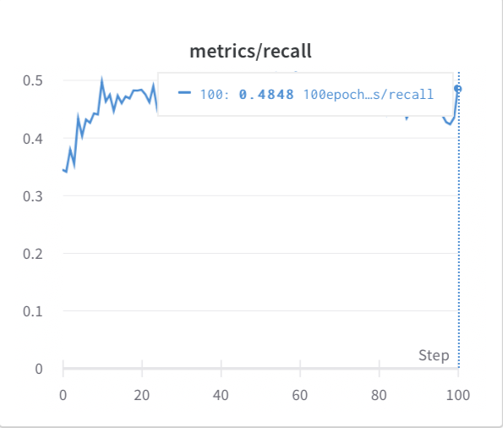
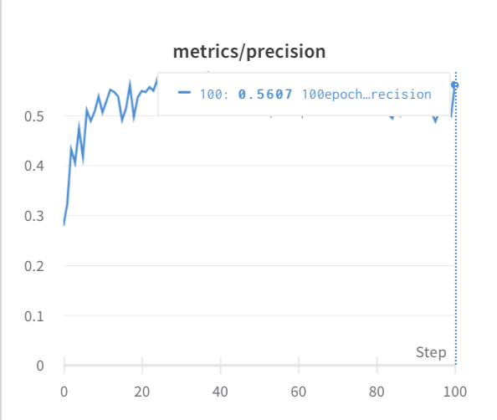
YOLOv5 | Model Performance

Slide 19
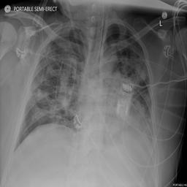
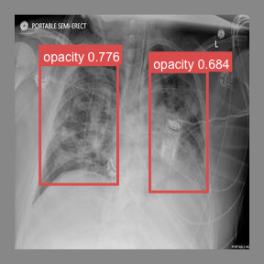
YOLOv5 | Result

Slide 20
Observation
Comparing model performance of Faster-RCNN with YOLOv5, we can see that YOLOv5 get a higher performance for doing the localization.

Slide 21
Lesion Classification

Slide 22
Vision Transformer | Training Details
Pre-processing:
Normalization
Data Augmentation
Image size: 224 * 224
Batch size: 16
Epoch:200
Optimizer: Adam
Initial learning rate: 2e-5

Slide 23
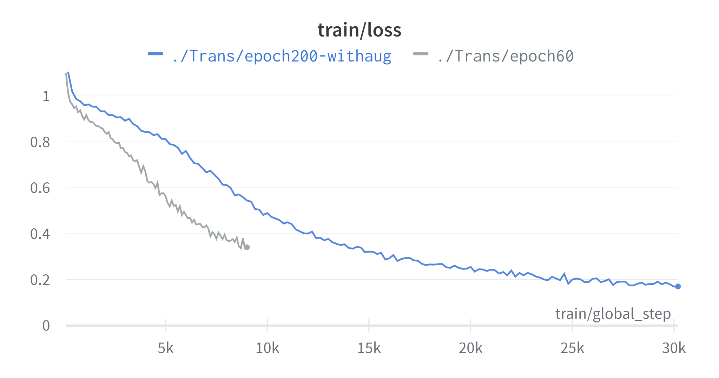
Vision Transformer | Results

Slide 24
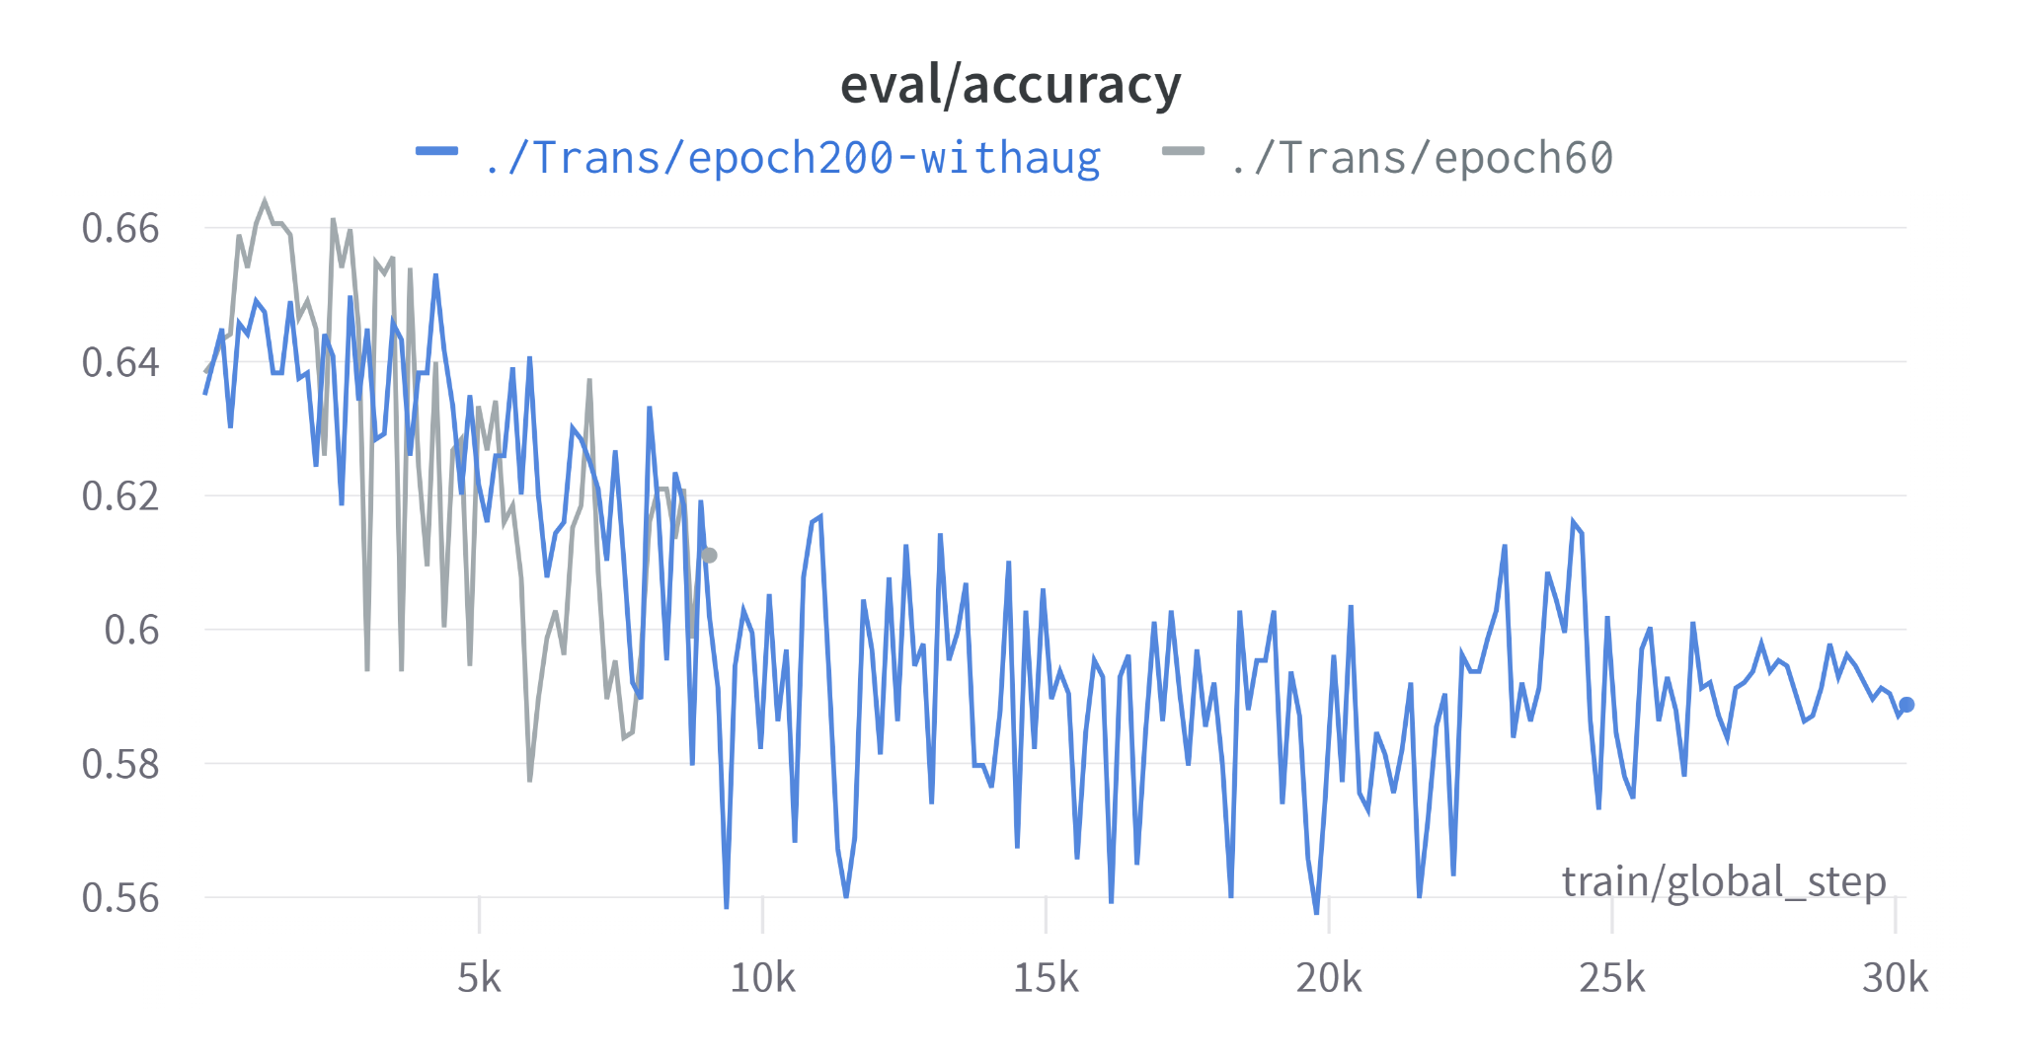
Vision Transformer | Results

Slide 25
ConvNext | Training Details
Pre-processing:
Normalization
Data Augmentation
Image size: 224 * 224
Batch size: 16
Epoch:200
Optimizer: Adam
Initial learning rate: 2e-5

Slide 26
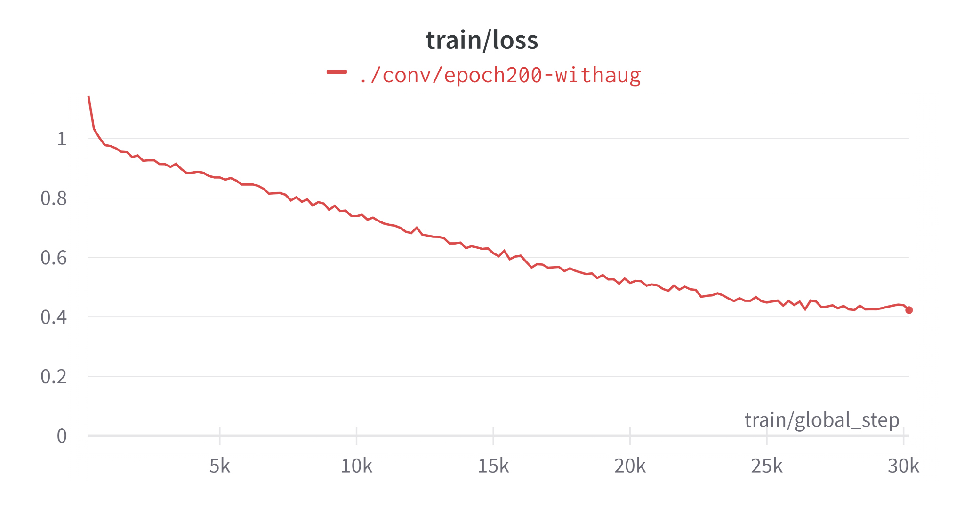
ConvNext | Results

Slide 27
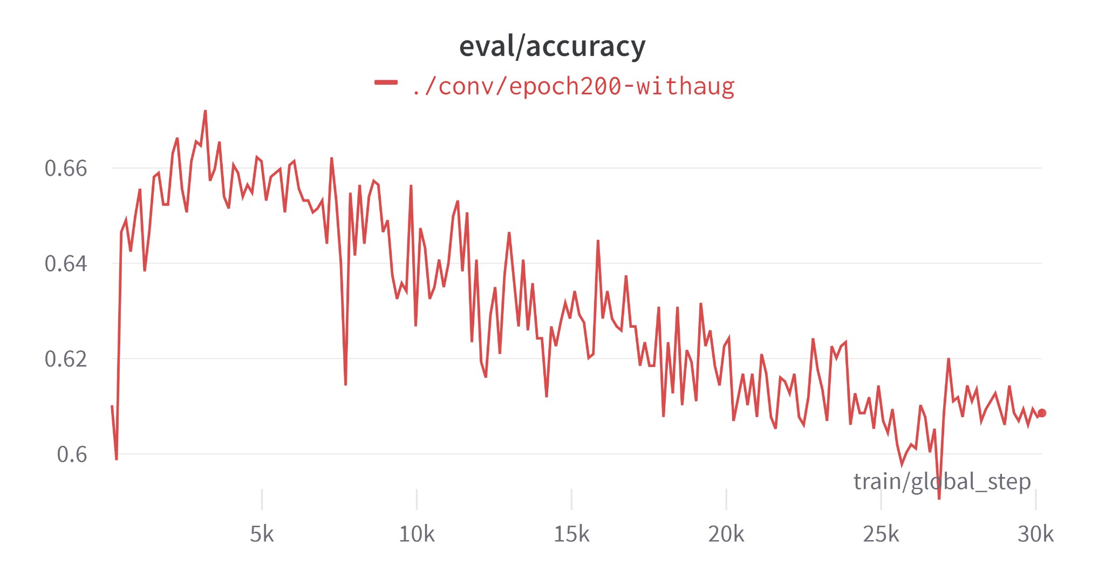
ConvNext | Results

Slide 28
EfficientNet b0 | Training Details
Pre-processing:
Data Augmentation
Method
K-fold
Image size: 224 * 224
Batch size: 32
Epoch: 100
Optimizer: SGD
Initial learning rate: 0.01

Slide 29
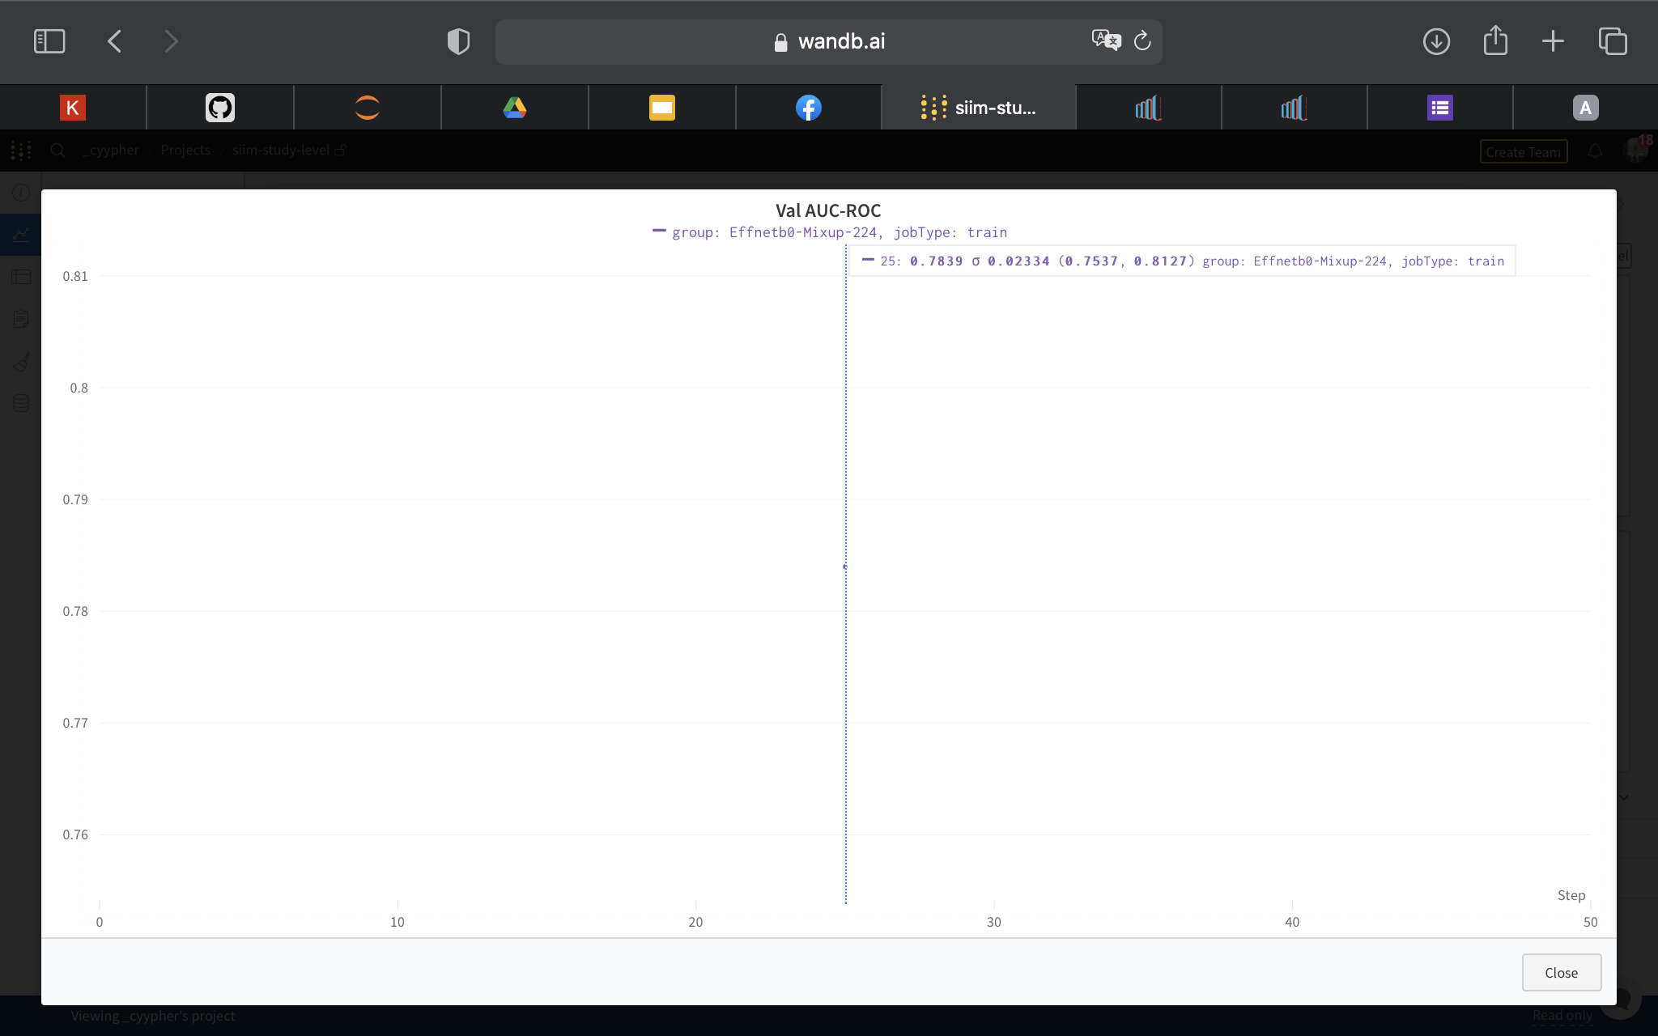
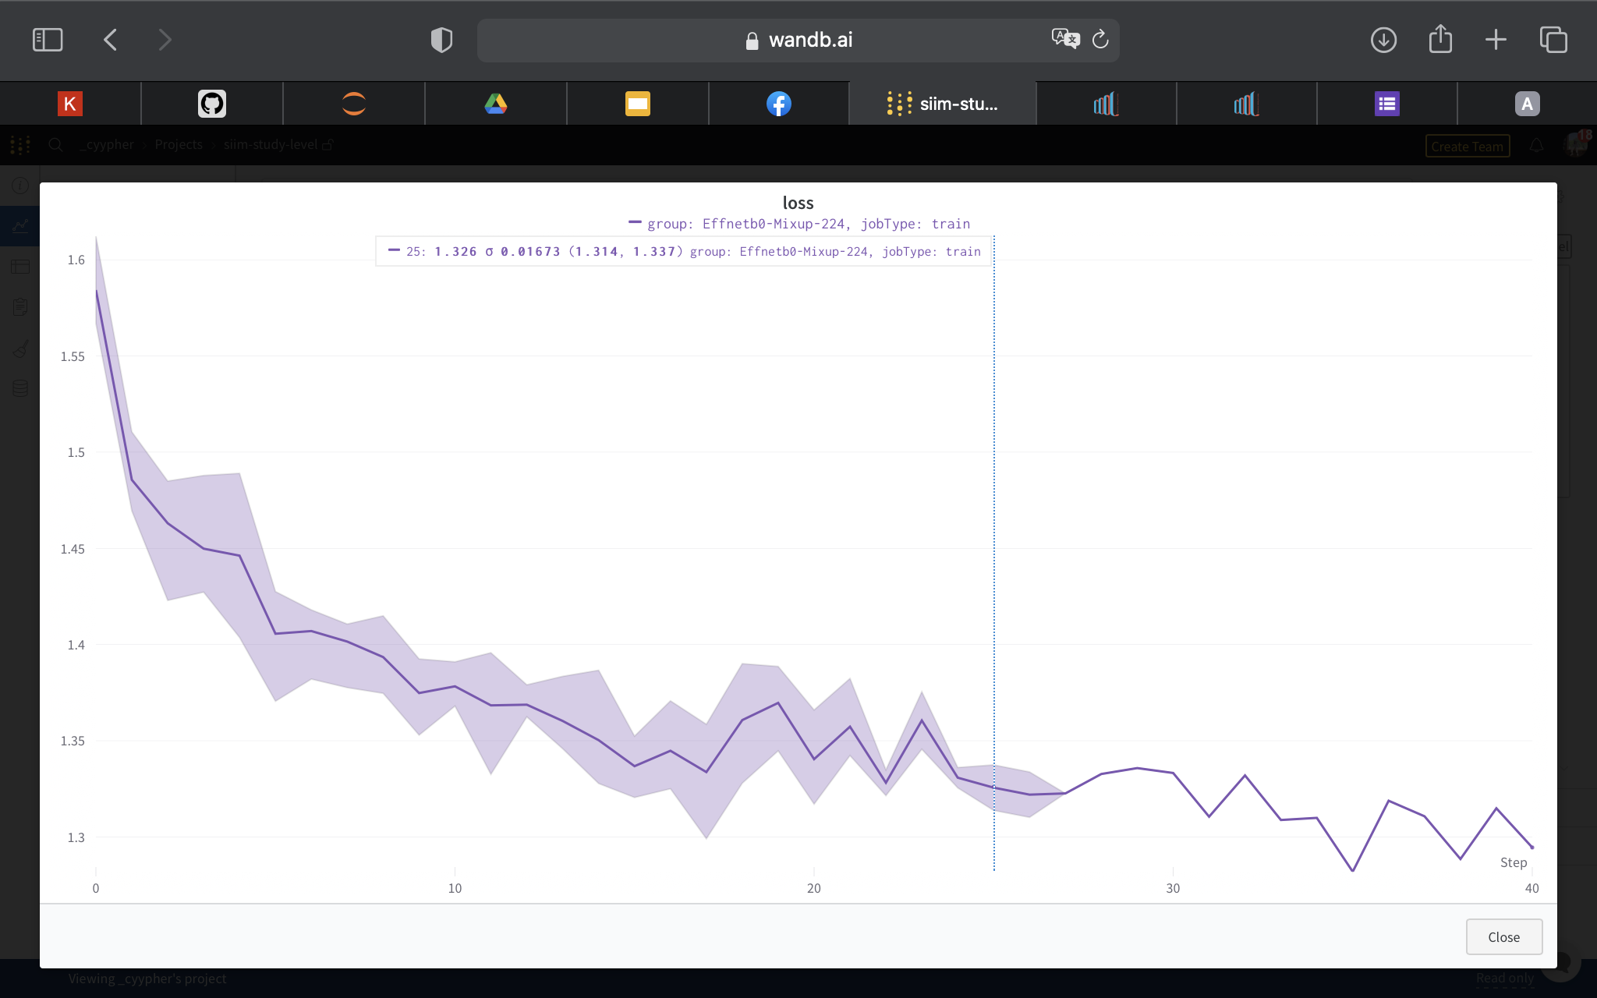
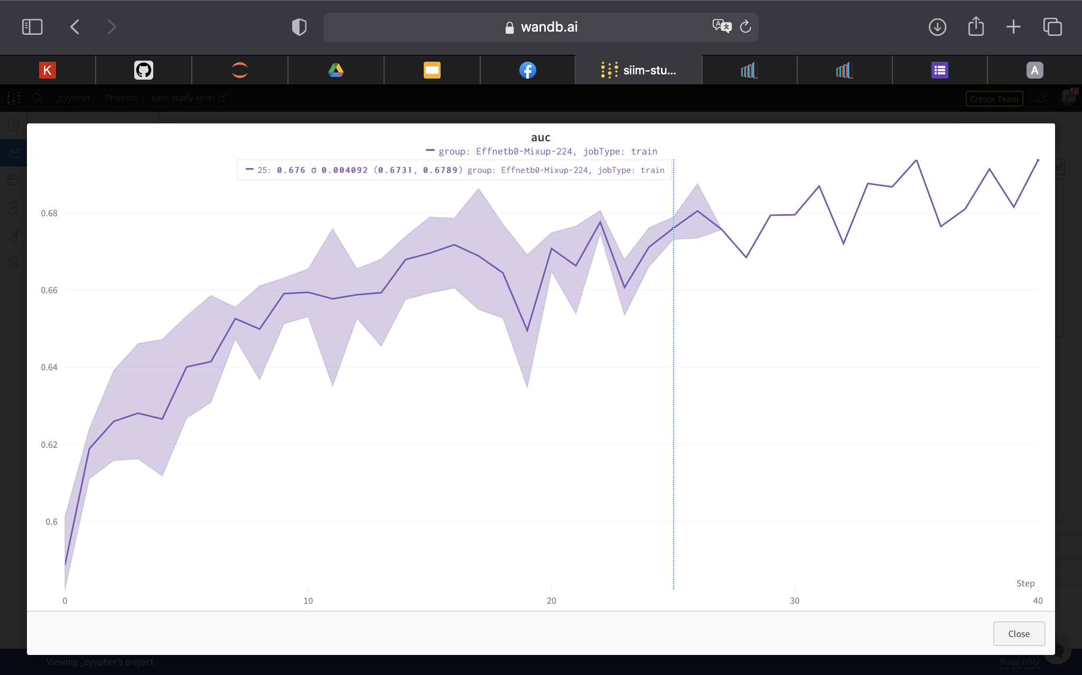
EfficientNet b0 | Model Performance

Slide 30
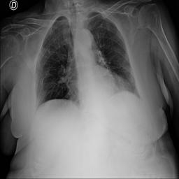
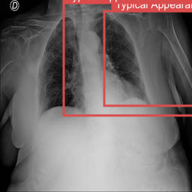
EfficientNet b0 | Results

Slide 31
NASNet | Training Details
Pre-processing:
Data Augmentation
Image size: 224 * 224
Batch size: 32
Epoch: 50
Optimizer: SGD
Initial learning rate: 0.001

Slide 32
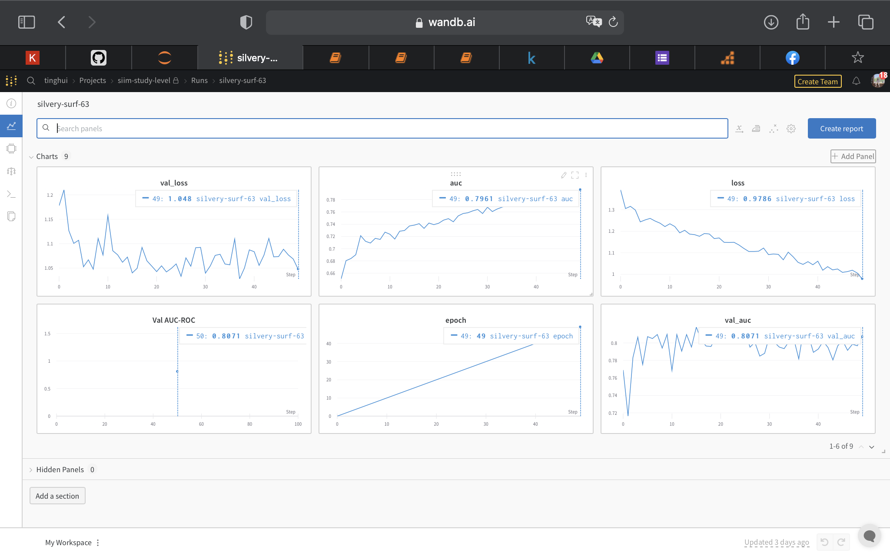
NASNet | Model Performance

Slide 33
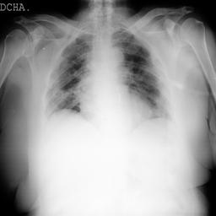
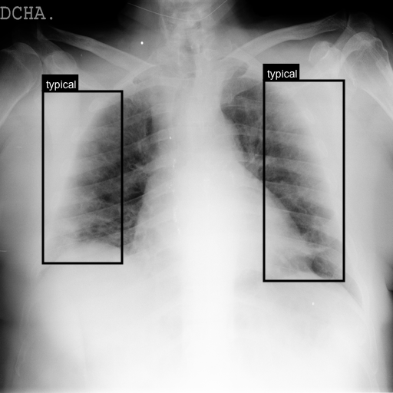
NASNet | Results

Slide 34
Observation
Comparing with model performance in different models, we can see that NASNet get a best performance for doing the classification. So, we choose NASNet as our final model to do this task in the end.

Slide 35
Do both tasks in one

Slide 36
Use YOLOv5 to do both tasks
Since we get not really good outcomes when we separate two tasks and use different models to deal with it, we are curious about whether combining localization and classification would be a better strategy.
As a result, we try to use one model, YOLOv5, to do both localization and classification.

Slide 37
YOLOv5 | Training Details
Pre-processing:
Normalization
Data Cleaning
Method
K-fold
Image size: 256 * 256
Batch size: 16
Epoch: 35
Optimizer: SGD
Initial learning rate: 0.01

Slide 38
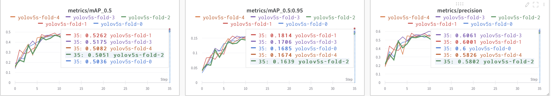
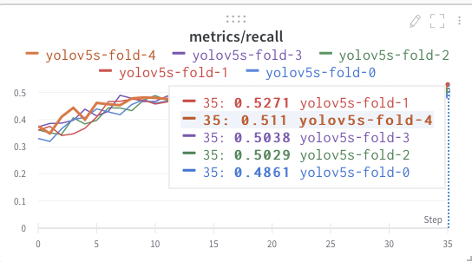
YOLOv5 | Model Performance

Slide 39
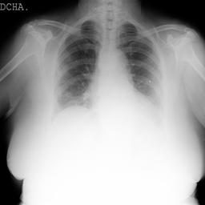
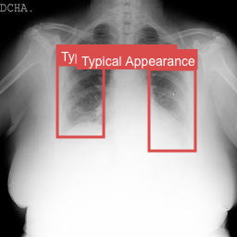
YOLOv5 | Results

Slide 40
Observation
By the model performance and observing the testing results, we can conclude that it will get a higher performance when we use YOLOv5 to do both classification and localization.
YOLOv5 doing both task
YOLOv5 only for localization

Slide 41
Code links
https://drive.google.com/drive/folders/1Z5x55RbECAg4ecc-tbjJY6YZ5r9Ay37i?usp=sharing

Slide 42
Conclusion
We use two different ways to do the detection for the lesion. One is seperating this problem into localization and classification. we try two Faster-RCNN and YOLOv5 to deal with localization, and get a higher mAP_0.5 in YOLOv5, which is 0.4727. For classification. we try ConvNex, Vision Transformer, EfficientNet b0 and NASNet. NASNet get the highest AUC with 0.7961.
The other way that we solve this problem is combining localization and classification in one task. In the end, we get a highest performance in this way.

Slide 43
References
https://www.kaggle.com/competitions/siim-covid19-detection
https://www.kaggle.com/datasets/xhlulu/siim-covid19-resized-to-256px-jpg
https://www.kaggle.com/datasets/xhlulu/siim-covid19-resized-to-224px-png
https://www.kaggle.com/code/ayuraj/train-covid-19-detection-using-yolov5/notebook
https://www.kaggle.com/code/ayuraj/train-study-level-classifier-w-b
https://www.kaggle.com/code/piantic/train-siim-covid-19-detection-fasterrcnn
https://huggingface.co/docs/transformers/main/en/model_doc/vit
https://huggingface.co/docs/transformers/main/en/model_doc/convnext#transformers.ConvNextForImageClassification
https://github.com/albumentations-team/albumentations

Slide 44
Answering questions
Q1: Isn't is much much harder to obtain a chest radiograph compared with rapid test or even PCR test? Could you elaborate more on the importance of your research?
A: Chest radiograph can be obtained in a few minutes while PCR could take hours or even days, and PCR test requires nurses to run the test station and to do the test, at a time when the nurse-patient ratios are already high, running a test station could only worsen the ratio. The precision of the rapid test is not as good as the chest radiograph detection.
Our purpose is to reduce the waiting time of the diagnosis as a result of this overwhelming medical system, so a covid-19 diagnosis with a chest radiograph might be a solution to it.

Slide 45
Answering questions
Q2: How do you get the x-ray image dataset? How many images for training / valid / tests?
A: The image datasets are from SIIM(Society for Imaging Informatics in Medicine), and there are 6054 images for training, and 1214 images for testing.

Slide 46
Answering questions
Q3: Why does your group choose these techniques? Do you have the comparison with the baseline?
A: In order to find the location of lesion and classify different syndromes, we choose CNN models. CNN models are state-of-art in the domain of computer vision.
Our dataset comes from a competition on kaggle. We can compare our result to other competitors.

Slide 47
Answering questions
Q4: How do you do the data augmentation?
A: In Pytorch torchvision, it provides transformation for images which are tensors or numpy arrays. For bounding box, we use Albumentation library.

Slide 48
Answering questions
Q5: 光是 dataset 標註就需要 domain knowledge，如何要跟 PCR 陽性的輕症(或無症狀)患者做連結?
A: The label was done by experts, and they are being labeled into 4 categories which are, "negative", "typical", "indeterminate", and "atypical".

Slide 49
Answering questions
Q6: 從loss來看，從頭一直到最後都在特定範圍持續跳動，應該沒有收斂啊?
A: This loss is for each mini-batch, so it looks oscillating. It actually converages in terms of epochs. (If I showed you training loss for each epoch, it would be a horizontal line.)

Slide 50
Answering questions
Q7: For optimizing RCNN, is SGD the best optimizer? Is there any reason that it's better than Adam or other more complex optimizers?
A: For RCNN, we tried SGD and Adam on RCNN, the mAP for Adam are almost 0, and SGD is slightly better (0.02), so we chose SGD.
For yolov5, we tried SGD and Adam on yolov5, the results are similar but SGD is slightly better on the mAP scores, so we chose SGD.

Slide 51
Answering questions
Q8: 請問你的結果會比醫師診斷更準確嗎?
A: We are not doctors, so we don't have the chance to compare our results with a doctor's diagnosis. However, it would be great to compare, so we'd know where to improve. Also, even if our results are not as good as doctors' diagnoses, it could still help by localizing the lesion area, so the doctors can make diagnoses more quickly.

Slide 52
Answering questions
Q9: Can it still detect if we only have mild symptoms?
A: Yes, our model will classify the located lesions into 4 categories which are, "negative", "typical", "indeterminate", and "atypical".

Slide 53
Answering questions
Q10: 抽菸跟沒抽菸的肺有分開訓練嗎?
A: We don't know if the dataset contains smoking data or not.

Slide 54
Answering questions
Q11: 有肺部舊疾會影響到判斷嗎 ?
A: We don't know for sure, but the dataset was collected with all kinds of chest radiographs, so it shouldn't be a problem.

Slide 55
Answering questions
Q12: How long does it take to train a model, and how about the accuracy?
A: For yolov5, we trained around 6 hours and its mAP_0.5 is 0.4727
For Faster RCNN, we trained around 1 hours and its mAP_0.5 is 0.02

Slide 56
THANK YOU

Slide 57
Team Members
Name/ID/Photos with individual responsibilities/contributions
Collaboration/communication mechanism
What is the problem?
Motivation: why is it important?
What’s the state of the art? i.e. survey of related work
Solution overview: what’s your big idea?
Technical details: How did you solve the problem?
methodology/algorithms (w/ links to your codes)
data resources w/ annotation, pre-processing, aggregation
tools or frameworks used
What are the results (experimental outcome, observation/analysis)?
References
Answers to questions during the final presentation

Slide 58
Data resources | Pre-processing
Faster-RCNN
normalization
data augmentation
YOLOv5
the content of annotations text file needs to do normalization
mosaic augmentation is already invovled inside the model
NASNet
Notes:
Predictions (object locations and classes) are made from one single network.
YOLO imposes strong spatial constraints on bounding box predictions, so it struggles to detect small or close objects. generalize to objects in new or unusual aspect ratios or configurations.

Slide 59
Methodology | YOLOv5
An object detection system targeted for real-time processing
Pros:
Fast Speed
Generalize image better
Cons:
limited detection
Notes:
region with cnn features
found some useful network
easily to implement

Slide 60
Methodology | NASNet
Notes:
region with cnn features
found some useful network
easily to implement

Slide 61
Faster-RCNN | Methods
An object detection system using Regional Proposal Network
Pros:
More Accurate
Cons:
Slow Speed
Notes:
object detection networks depend on region proposal algorithms to hypothesize object locations

Slide 62
Methodology | K-fold
Notes:
region with cnn features
found some useful network
easily to implement

